Slide 1
Passing data from html to python script and vice versa using flask
Prepared by:
Mohamad Ali A. Calanda
Janna May P. Gensaya
AI Face Swapping Team

Slide 2
Installing PIP
To run the file, first we need to install pip to the system if not yet installed.
PIP will help us to install the necessary libraries to the program.
Check this steps from geeksforgeeks website on how to install the pip
https://www.geeksforgeeks.org/how-to-install-pip-on-windows/
Note: I’m using the latest version of Python here and my OS is Windows 10

Slide 3
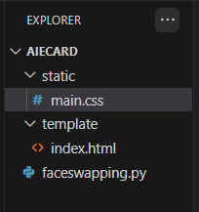
Setting up the custom folders
Inside the AIECard folder, I created static and template folders. A static folder where CSS files and other media files are stored, and a template folder where an HTML document is stored. And the Python script (faceswapping.py) inside the AIECard. Don’t worry I’ll upload this custom folders along with this presentation so you can download it.

Slide 4
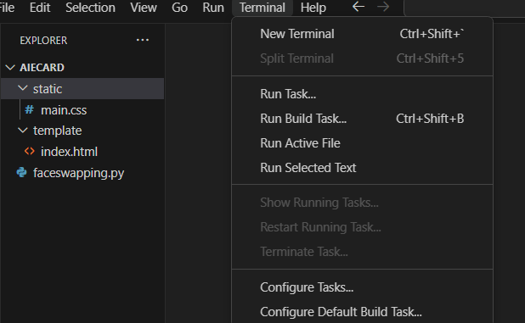
Installing the virtual environment in the same folder
Step 1: Open a new terminal

Slide 5
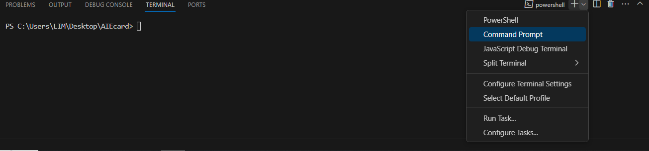
Installing the virtual environment in the same folder
Step 2: Select and open the Command Prompt

Slide 6
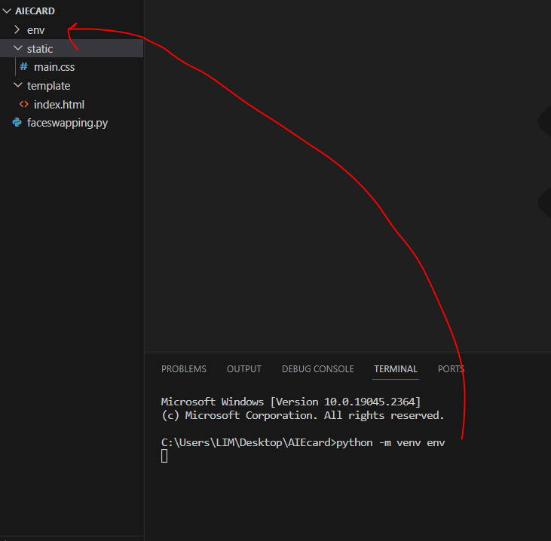
Installing the virtual environment in the same folder
Step 3: In the command prompt,
type: python -m venv env and click enter
This will create or import a folder name ‘env’ to the same folder.

Slide 7
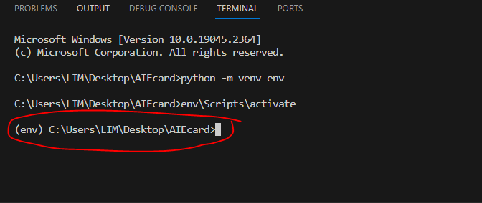
Installing the virtual environment in the same folder
Step 4: And lastly, type: env\Scripts\activate and click enter.

Slide 8
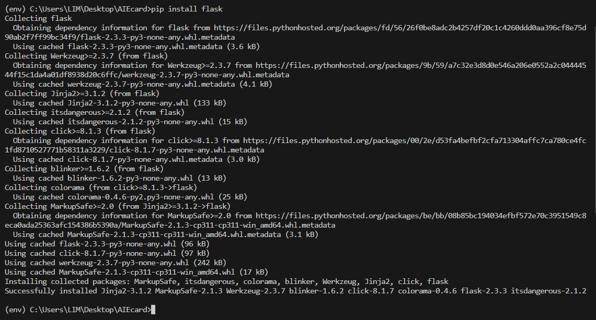
Installing flask and other libraries
Type: pip install flask

Slide 9
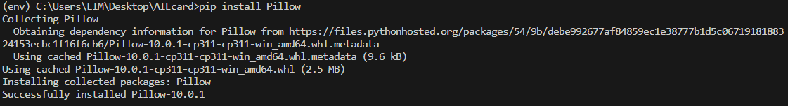
Installing flask and other libraries
In faceswapping.py, we need to install also the Pillow (PIL), OpenCV and mediapipe
In the same command prompt, type: pip install Pillow

Slide 10
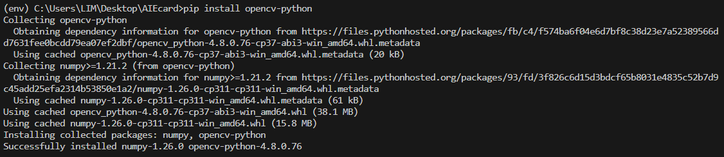
Installing flask and other libraries
For OpenCV, type: pip install opencv-python

Slide 11
Installing flask and other libraries
For OpenCV, type: pip install opencv-python
And for mediapipe, type: pip install mediapipe

Slide 12
CODE

Slide 13
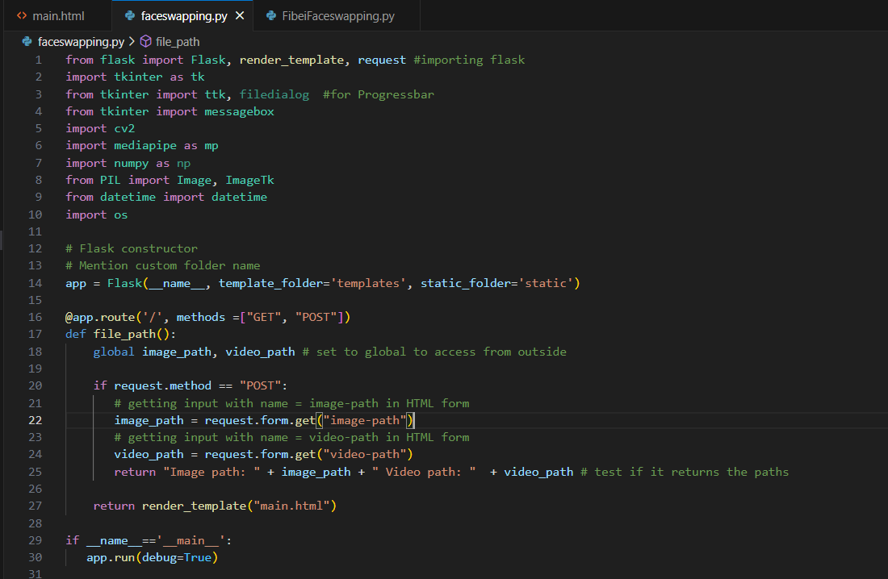
Get the image and video path from HTML and pass to the python script, and store to the path to the variables (abs_path_image and abs_path_video)

Slide 14
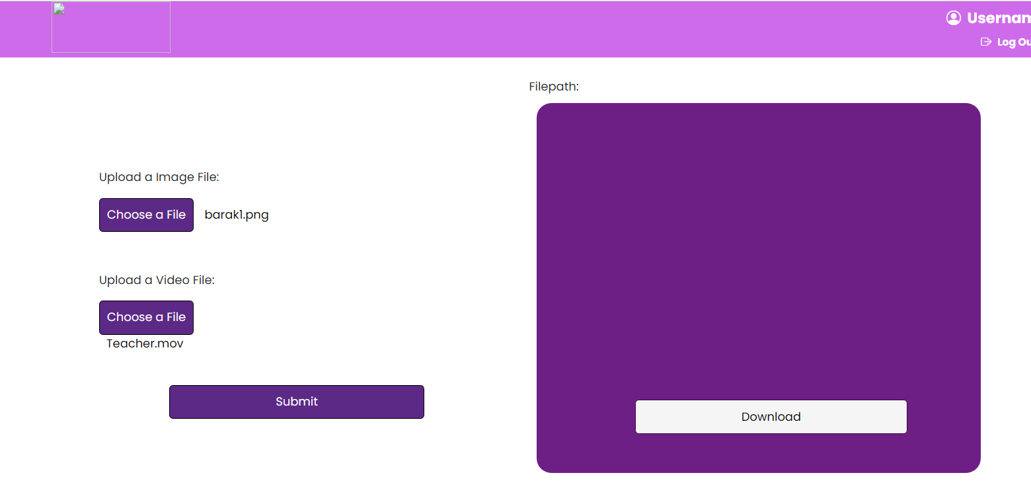
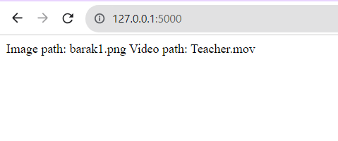
It shows the output of previous code to see if it really works. It returned the filenames of the media files from the Python script.

Slide 15
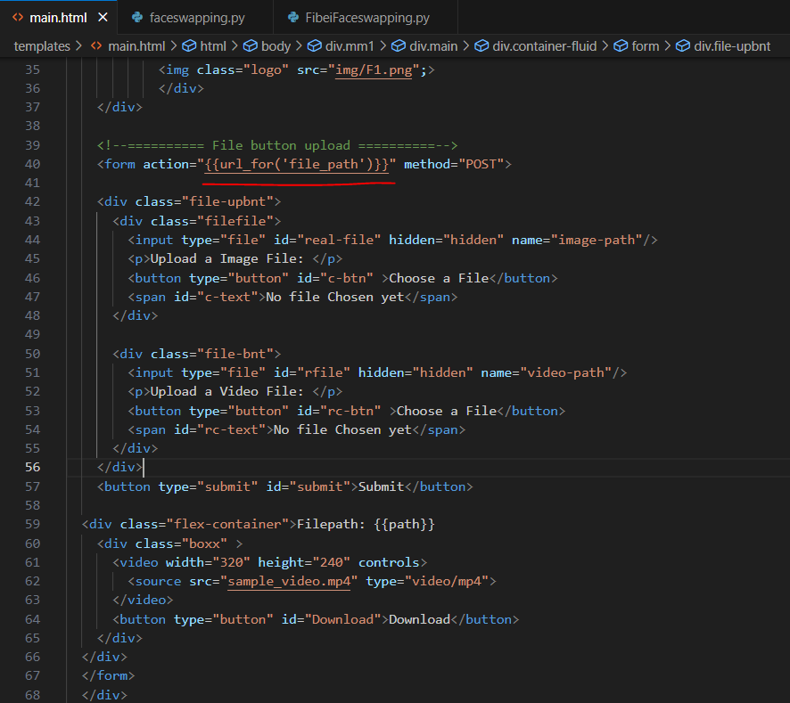
Set the action with the name of the function (file_path) from python script.

Slide 16
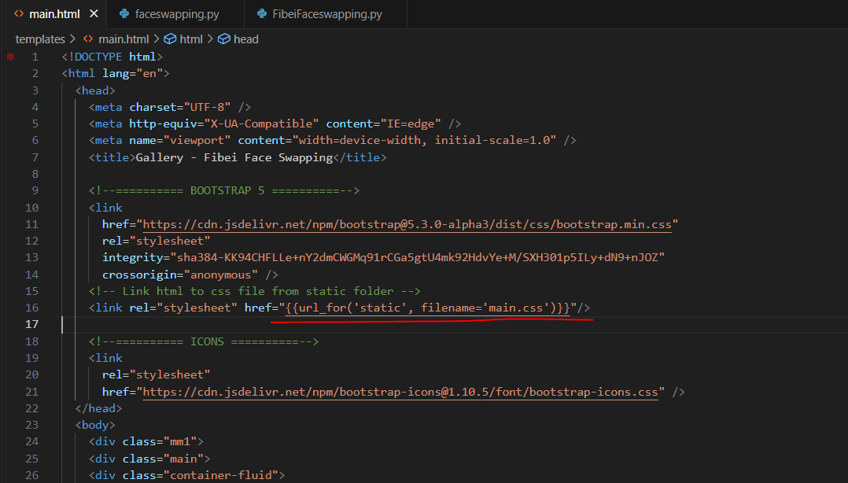
Change the value of href that links to the css, the first argument is the name of folder (static) and second argument, the filename with the value of the name of css file.

Slide 17
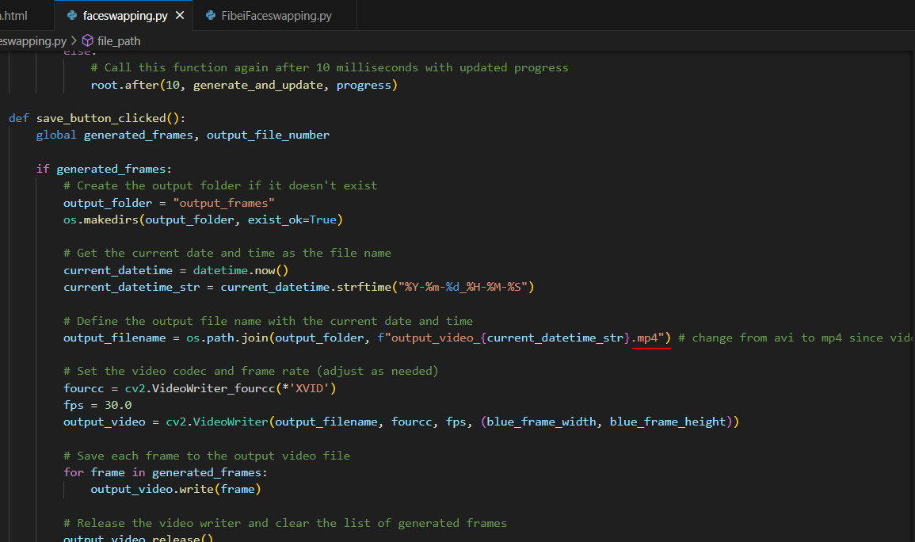
Change avi to mp4 because HTML video doesn’t support avi format.

Slide 18
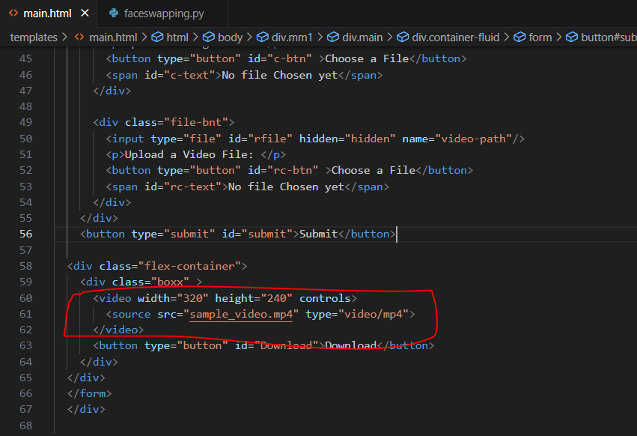
I inserted a video tag in the box class. I also put in the same folder the sample_video.mp4 and the HTML document. I tried it first before proceeding to the problem of how to pass the generated video from a Python script and display it in the HTML or browser.

Slide 19
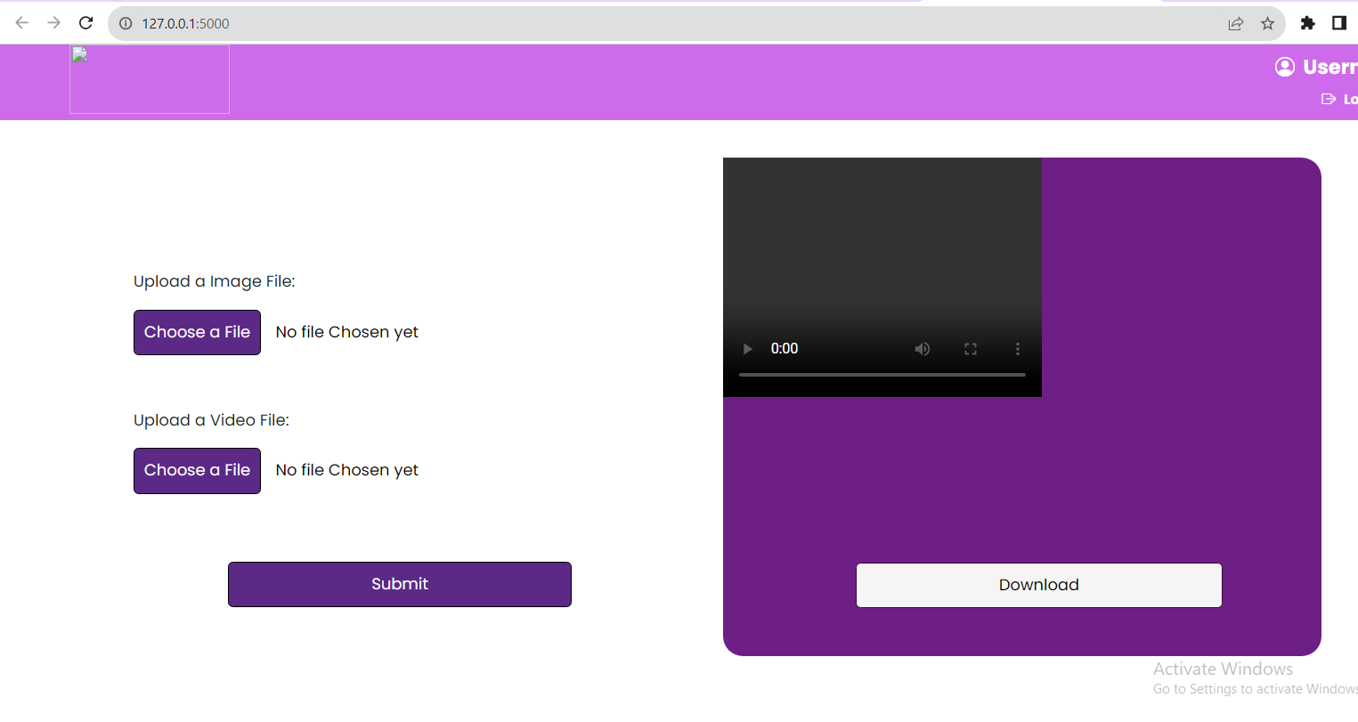
Here is the output of the previous HTML file; it displayed the video, but it cannot play as normal.

